Slide 1
IMAGE CAPTION GENERATOR USING RESNET AND LSTM AISHWARYA DEVI 2021503501

Slide 2
PROBLEM STATEMENT:
The project aims to develop an image caption generator using deep learning techniques, specifically by combining a convolutional neural network (CNN) for image feature extraction (ResNet) with a recurrent neural network (RNN) such as Long Short-Term Memory (LSTM) for generating captions using Flickr8k dataset. Flickr8k dataset contains 8096 images with corresponding captions for each image.

Slide 3
PROPOSED SOLUTION:
ResNet (Image Feature Extraction):
Utilize a pre-trained ResNet model to extract features from images. The ResNet model is typically pre-trained on large image datasets like ImageNet, enabling it to capture high-level features from images effectively.
Pass the image features through a Dense layer to reduce the dimensionality of the features to a desired embedding length, which serves as the input to the caption generation model.
Repeat the vector to match the maximum sequence length (MAX_LEN) of captions, ensuring compatibility with the caption generation model.

Slide 4
PROPOSED SOLUTION:
LSTM (Caption Generation):
Build a sequential model for caption generation. The input to this model is a sequence of word indices representing the captions.
Start with an Embedding layer, which maps each word index to a dense vector representation.
Feed the embedded sequences into an LSTM layer with 256 units. This LSTM layer processes the sequential information from the captions.
To generate output for each time step, apply a TimeDistributed Dense layer to transform the LSTM outputs into the desired embedding length.

Slide 5
PROPOSED SOLUTION:
Combining Image and Caption Models:
Concatenate the outputs of the ResNet model and the LSTM-based caption model to merge the information from image features and sequential captions.
Pass this concatenated output through two LSTM layers: the first with 128 units and the second with 512 units, both returning sequences.
Finally, feed the output through a Dense layer with softmax activation to produce the probability distribution over the vocabulary for generating the next word in the caption.

Slide 6
SYSTEM APPROACH:
Hardware requirements:
1. CPU:
A multi-core CPU is recommended for preprocessing the data, training the model, and performing inference.
2. Memory (RAM):
Sufficient RAM of atleast 8GB is crucial for loading and processing large datasets, storing model parameters, and performing computations during training and inference.
3. Internet Connection:
An internet connection is required primarily for downloading datasets, pre-trained models, and possibly additional libraries or packages.The speed of the internet connection will affect the time it takes to download large files, such as pre-trained models or datasets.

Slide 7
SYSTEM APPROACH:
Software requirements:
1. Python: This project uses python programming language. The recommended version for this project is Python 3.x (e.g., Python 3.7 or higher).
2. Google Colab: Google Colab provides a cloud-based Python development environment with free access to GPUs.
3. Libraries:
NumPy: For numerical computing and array operations.
Pandas: For data manipulation and analysis.
Matplotlib: For data visualization and plotting.
OpenCV (cv2): For image processing and computer vision tasks.
TensorFlow: Deep learning framework for building and training neural networks.
TQDM: For displaying progress bars during iterations.

Slide 8
ALGORITHM AND DEPLOYMENT:
Data preparation:
Download the dataset from flickr8k dataset
Load the images and captions separately from the dataset.
Preprocessing likely involves tasks such as lowercase conversion, punctuation removal, and tokenization.
The resulting dictionary contains image names as keys and lists of preprocessed captions as values.

Slide 9
ALGORITHM AND DEPLOYMENT:
Resnet50:
Design the ResNet50 model using TensorFlow
The pre-trained ResNet model extracts features from each image.
Features are stored in a dictionary with image names as keys.
The process is limited to a specified number of images to prevent memory overload.
LSTM:
Design the LSTM model using TensorFlow
The input to this model is a sequence of word indices representing the captions.
LSTM layer processes the sequential information from the captions.

Slide 10
ALGORITHM AND DEPLOYMENT:
Training:
Compile the final model using categorical cross-entropy loss and the RMSprop optimizer.
Train the model using both the image features and corresponding captions. The model learns to generate captions for images by minimizing the cross-entropy loss between the predicted and actual captions.
During training, monitor the accuracy metric to assess the model's performance.
Deployment:
The trained model and associated code are deployed into a Github repository
Instructions for executing the file and setting up the environment are included in the README file

Slide 11
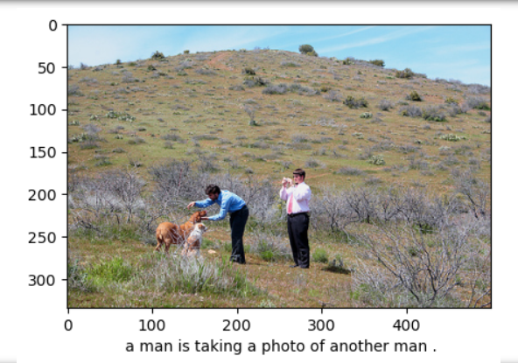
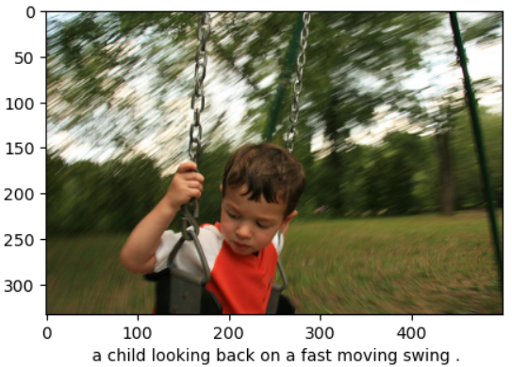
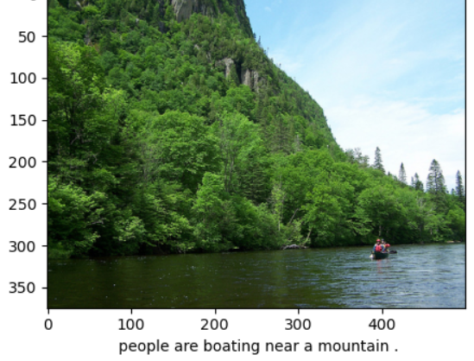
RESULTS:

Slide 12
CONCLUSION:
The project has achieved its goal of developing an image caption generator by combining ResNet for image feature extraction with LSTM for caption generation. Through the implementation of a deep learning architecture and meticulous data preparation, the model successfully learned to generate meaningful captions for diverse images.

Slide 13
Thank you

